Slide 1








The Lighters
Our one desire is to extinguish the fire

Slide 2
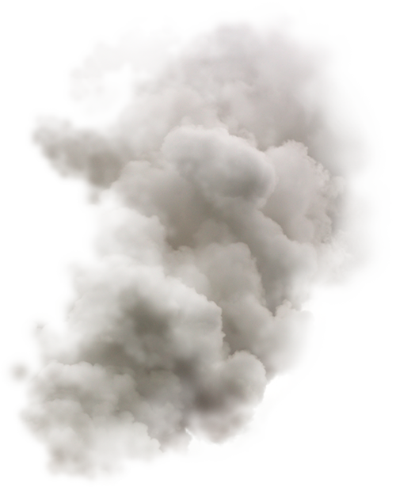



No Smoke(app)
Stay alert with our brand new concept app to help you fight fire with fire.

Slide 3
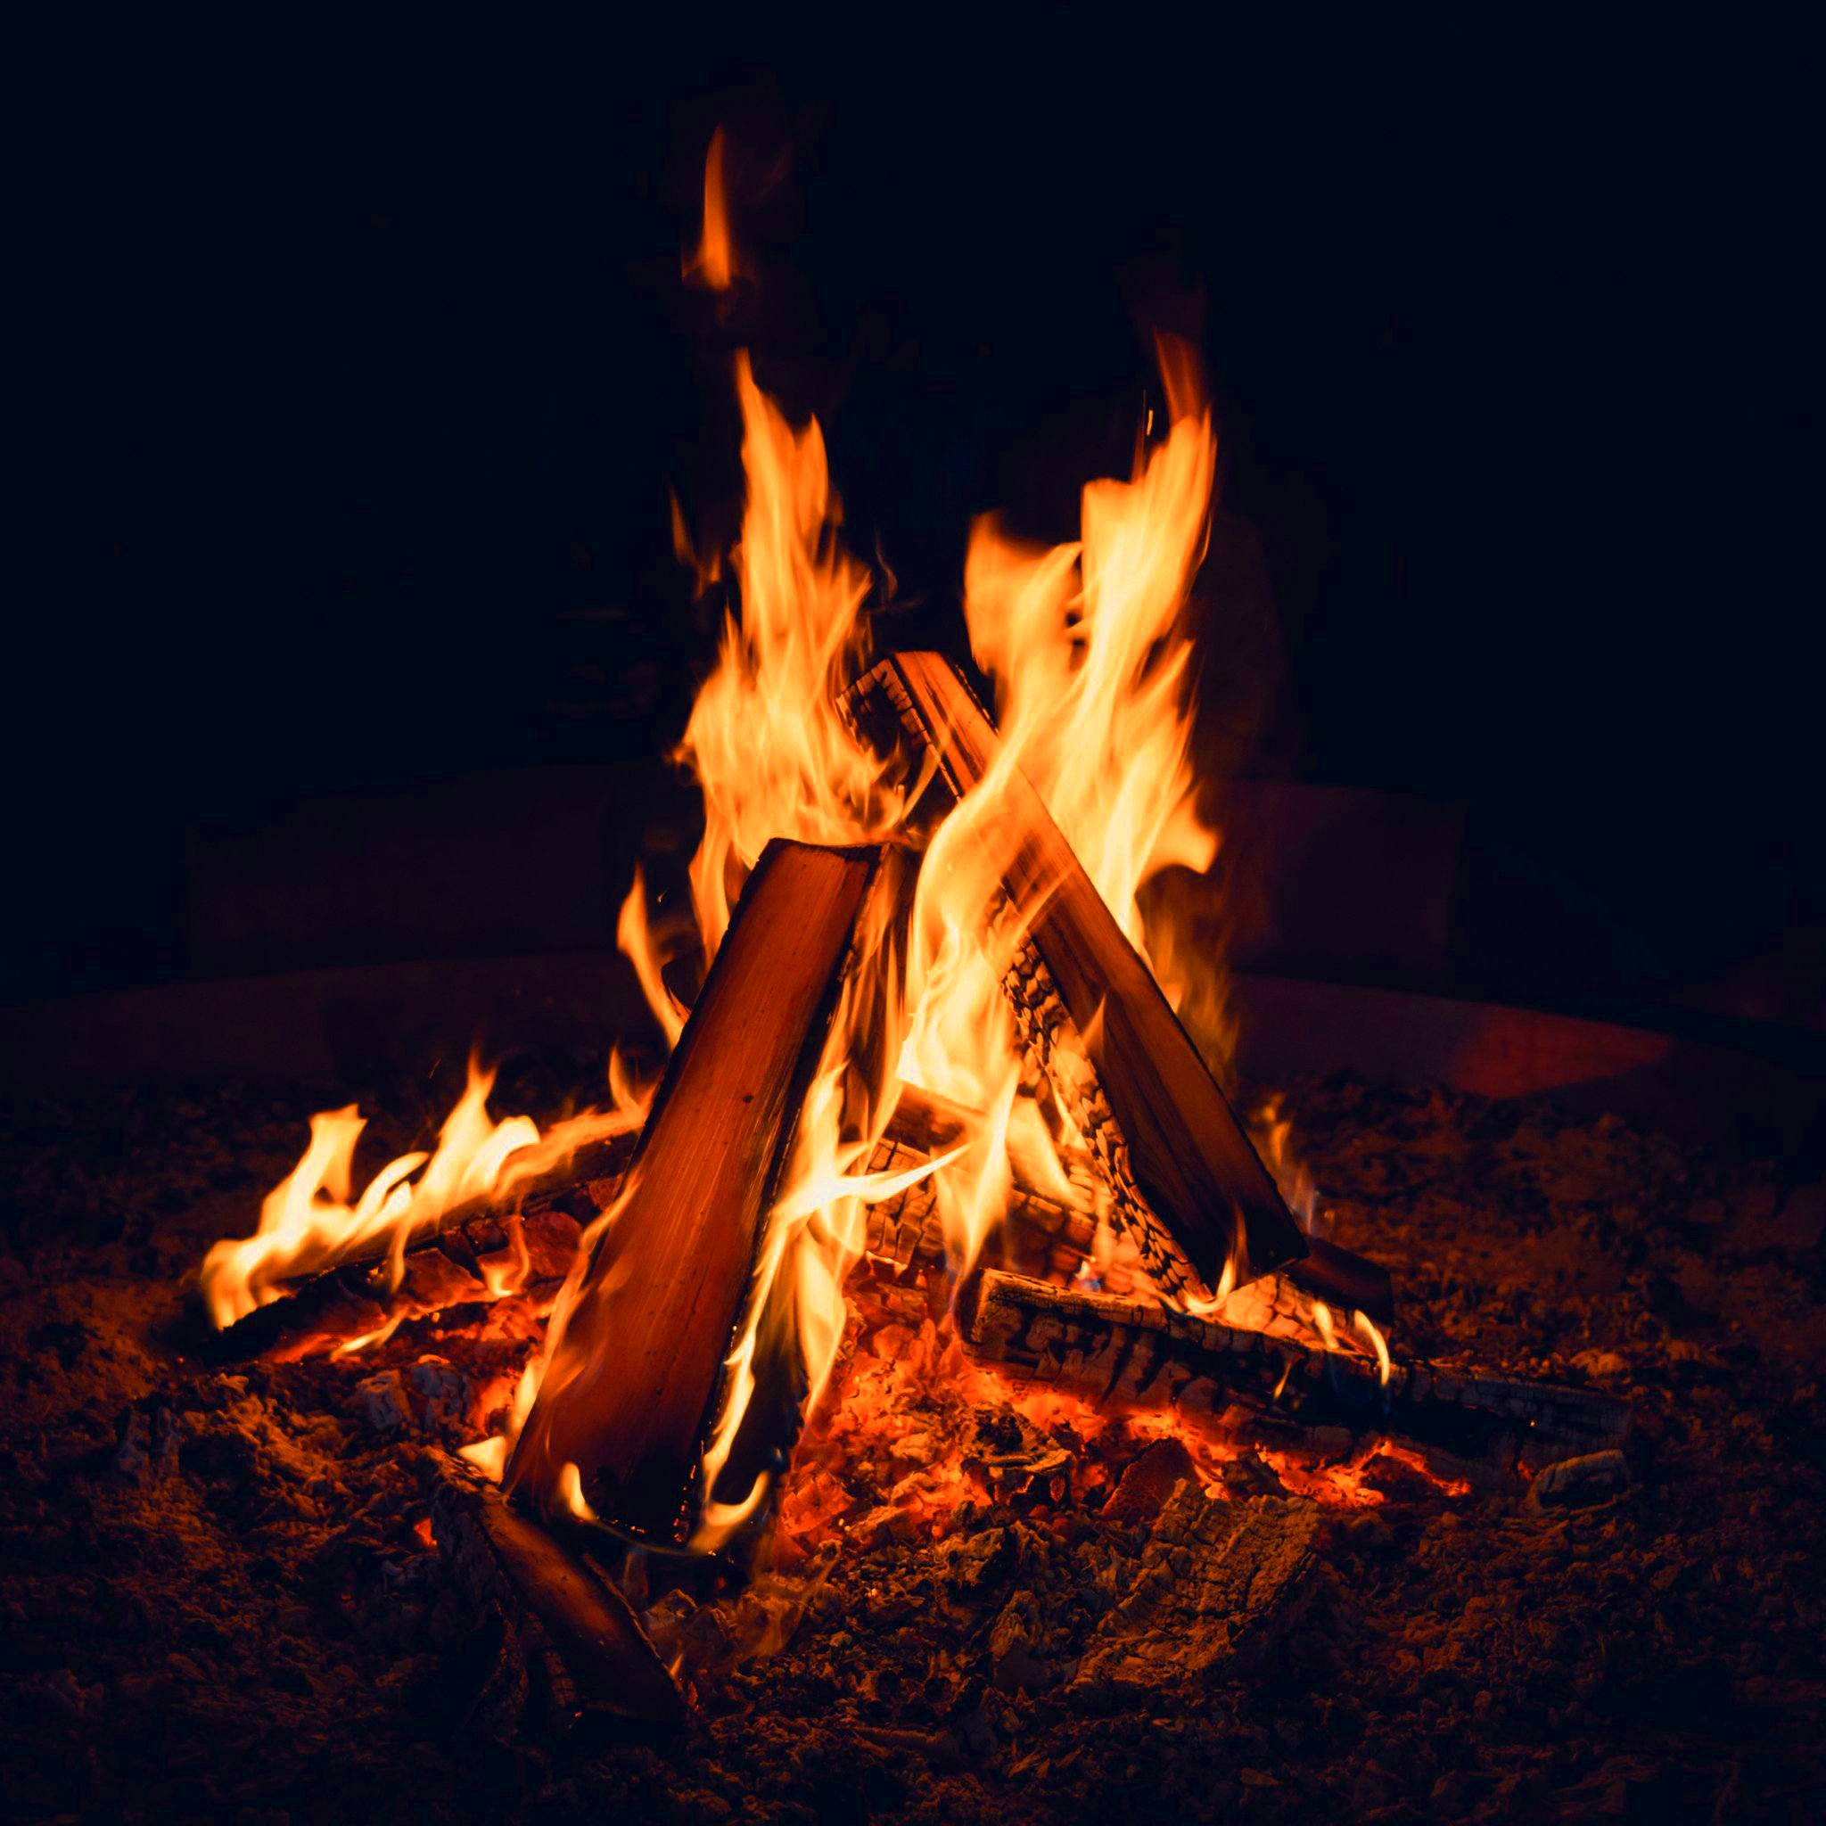
Fire
Fire Classifications
Class A
Class B
Class C
Class D

Slide 4
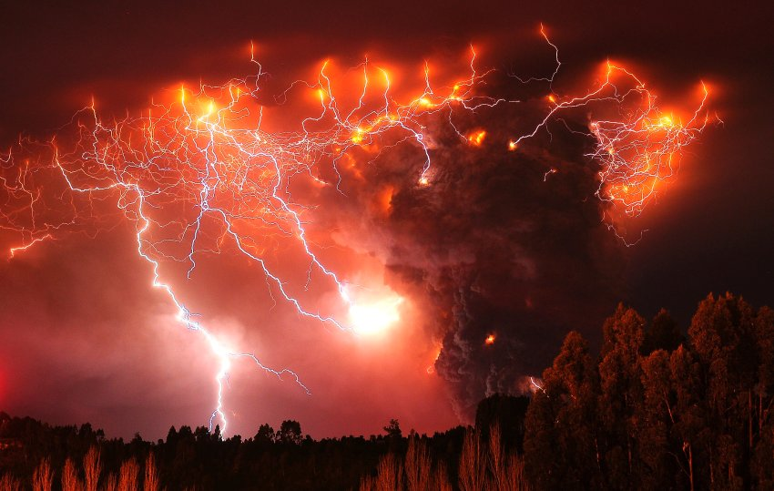
Cause and Effect
CAUSEs
occur naturally –lightning striking trees
Human Recklessness
EFFECTS
Consumes up to 3,000,000 hectares of forest and brush every year
Causes more than 100,000 wildfires is the US annually

Slide 5
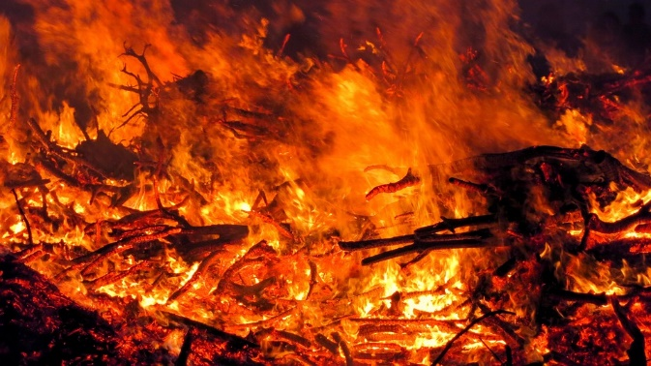

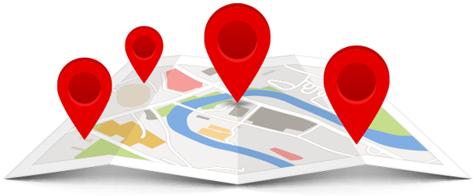
Witness Report
Upload media complete with brief description and location.
Check and verify other fires in your area.
Severe forest fire in Avalon CA

Slide 6
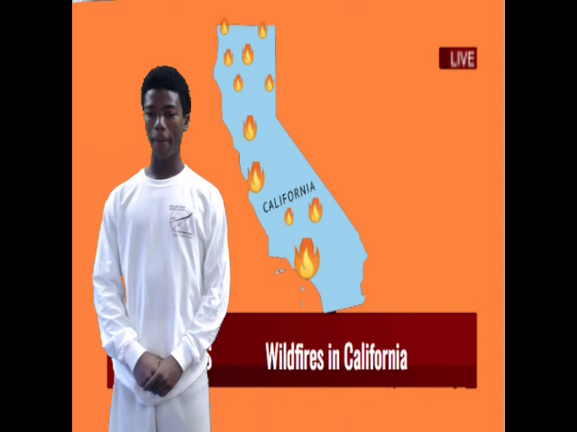
News Report
Anchor
Miles Richardson

Slide 7
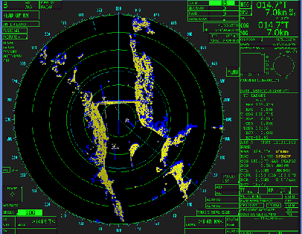
Radar
Has interactive maps to show the location
Will track the fume cloud and track the heat signatures

Slide 8
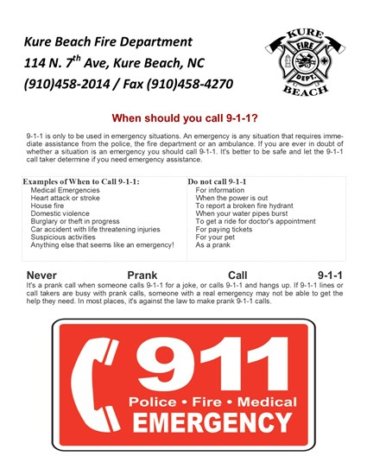

Local Options/Info
Example:
App will include emergency service numbers.
Standard procedure for people trapped in a fire.
And general fire safety tips
You may also have access to options specific to your location.

Slide 9
Works Cited
https://nex.nasa.gov/nex/static/htdocs/site/extra/opennex/
https://firms.modaps.eosdis.nasa.gov/
https://inciweb.nwcg.gov/
https://irw
https://irwint.doi.gov/
https://www.nifc.gov/drones/index.html
https://landweb.modaps.eosdis.nasa.gov/cgi-bin/NPP_QA/displayCase.cgi?esdt=NPP_AF&caseNum=PM_NPP_VAFIP_18215&caseLocation=cases_data
https://www.smokeybear.com/en/prevention-how-tos
https://eos.org/project-updates/meteorologists-track-wildfires-using-satellite-smoke-images
http://www.americanfireandlifesafety.com/classes-of-fires.html

Slide 10

Special thanks to all of our sponsors / volunteers

